Slide 1


جامعة بنهـــــا
كلية الحاسبات والذكاء الاصطناعي
Orthopedic classification.
Machine Learning Project.
Team members:
Sherif Ashraf Ahmed Roshdy.
Abdelrahman Mohamed Khalil. Mohamed Hosny Mosad.
Yahia Zakria Ebrahim. Sobeh Salah Sobeh.

Slide 2
Introduction.
Domain of problem.
Software Details and Project Objective.
Dataset.
CONTENTS
Information about dataset.
Exploratory Dataset.
The Algorithms used to classification
Data preprocessing for machine learning.
Voting many classifier (KNN, Naive Bayes classifiers, Decision tree classifier) to make best decision.
Conclusion.
the decision of solving problem.
Save model.
Load model and test it with example.

Slide 3
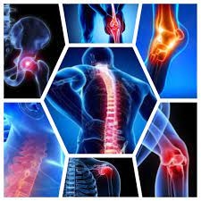
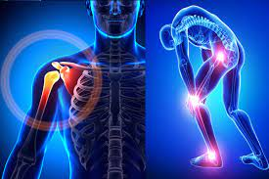
Introduction
Domain of problem.
Orthopedic relating to the branch of medicine dealing with the correction of deformities of bones or muscles.
medical information
3

Slide 4
Introduction
Conn.
If you suffer from pain in the bones, the bone examination will show whether this pain is normal or abnormal.
This is important because, in the event of abnormal pain, you will have to go to a specialist. After all, it may be very dangerous, such as Joints Dislocation or Fractures.
Bone, normal or abnormal, is an important tool for detecting cancer spread in the bones from the site of the original tumor, such as breast or prostate cancer,
It helps in repairing and preventing deformities in children at an early stage, and these deformities result from some factors that may affect the body while it is still at the embryo stage.
4

Slide 5
Introduction
Software Details and Project Objective.
Software Details:
Python (libraries) >> Pandas, SKLearn, Seaborn, Matplotlib, numpy.
Dataset >> Kaggle.
Project Objective
Used machine learning algorithms to classify a patient’s condition as normal or abnormal based on various orthopedic parameters
5

Slide 6
Dataset.
Biomechanical features of orthopedic patients | Kaggle

Slide 7
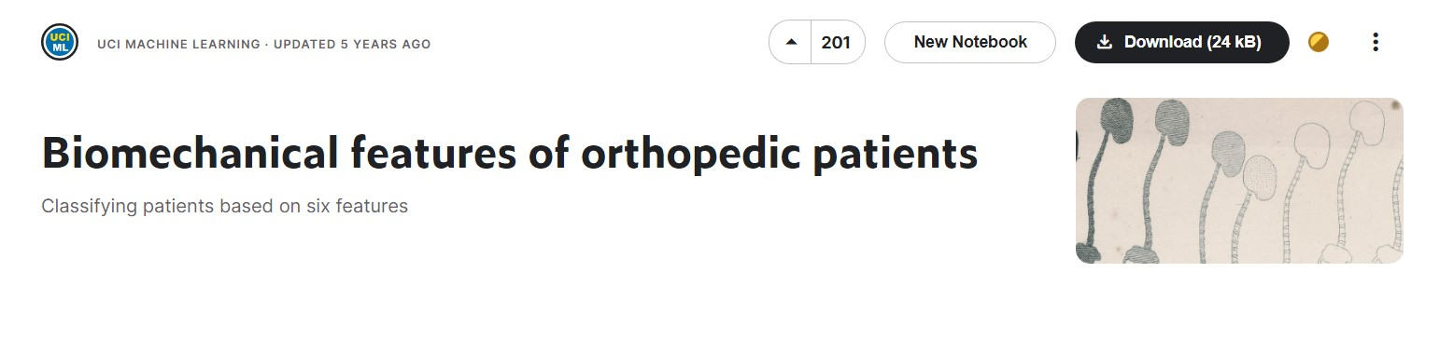
Dataset.
Information about dataset
Biomechanical features of orthopedic patients
Kaggle image.
7

Slide 8
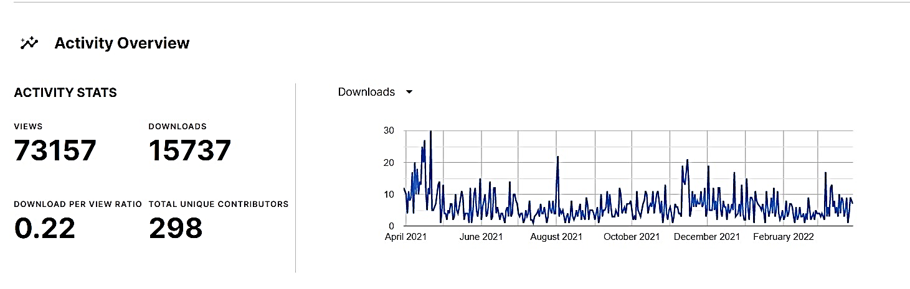
Dataset.
Conn.
The task consists in classifying patients as belonging to one out of two categories: Normal or Abnormal.
Activity Overview of dataset
8

Slide 9
Dataset.
Conn.
Each patient is represented in the data set by six biomechanical attributes derived from the shape and orientation of the pelvis and lumbar spine (each one is a column)
Pelvic incidence حدوث الحوض
pelvic tilt إمالة الحوض
lumbar lordosis angle زاوية قعس قطني
sacral slope منحدر عجزي
pelvic radius نصف قطر الحوض
grade of spondylolisthesis درجة انزلاق الفقار
9

Slide 10
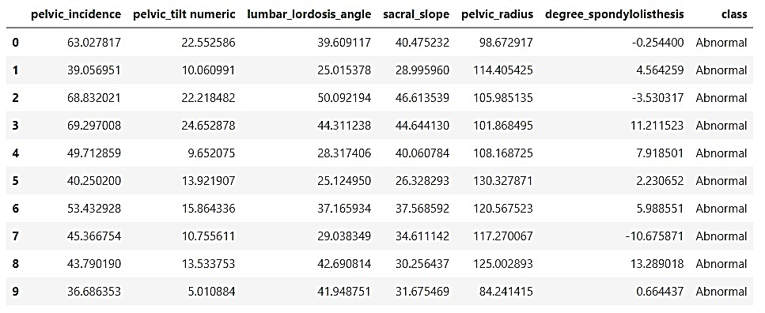
Dataset.
Exploratory Dataset.
Show the first 10 rows.
10

Slide 11
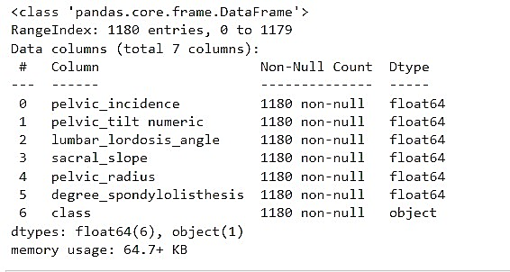
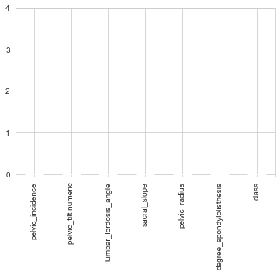
Dataset.
Conn.
Print a concise summary of a DataFrame.
The shape >> (1180,7)
Check the non-null values
11

Slide 12
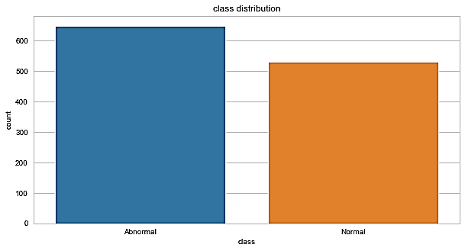
Dataset.
Conn.
Represent the number of output: (Checking for imbalanced output)
Normal (649 patients) or Abnormal (513 patients).
12

Slide 13
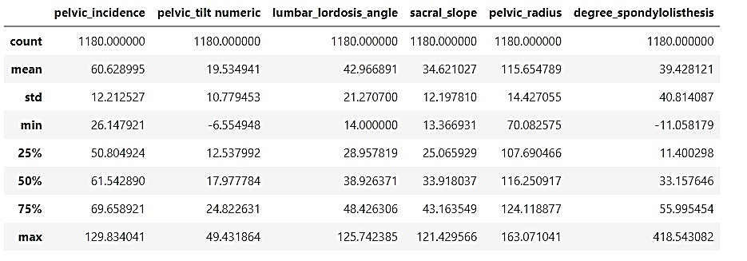
Dataset.
Conn.
Show descriptive statistics include those that summarize the central tendency, dispersion and shape of a dataset's distribution.
13

Slide 14
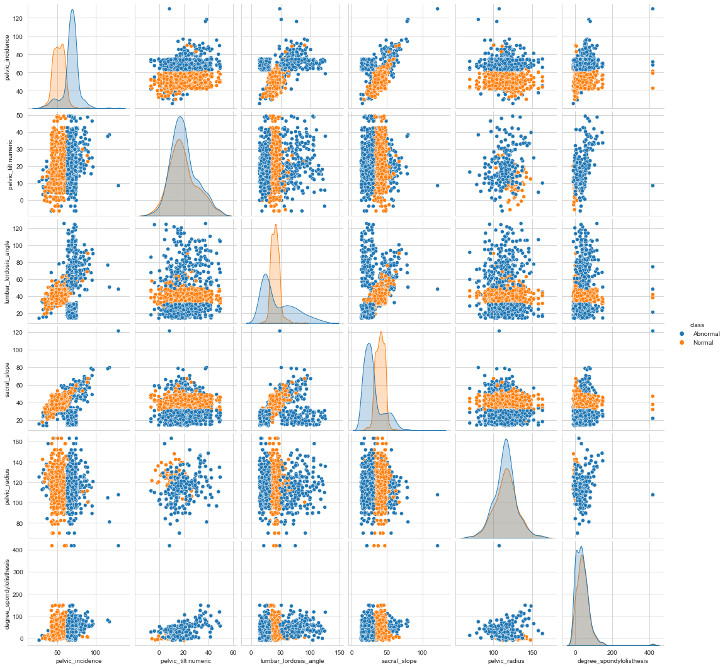
Dataset.
Conn.
Plot pairwise relationships in a dataset using seaborn.pairplot function.
14

Slide 15
Dataset.
Conn.
FacetGrid class helps in visualizing distribution of one variable as well as the relationship between multiple variables separately within subsets of your dataset using multiple panels.
15

Slide 16
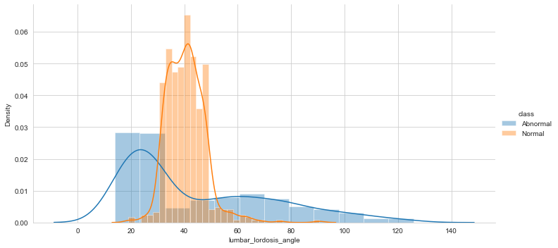
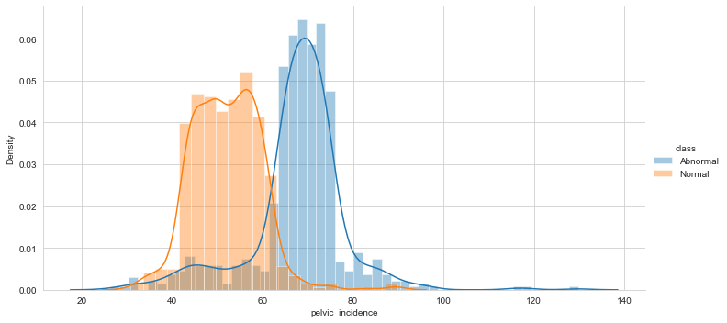
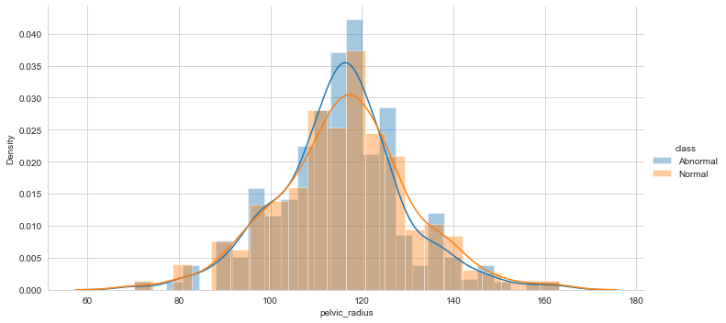
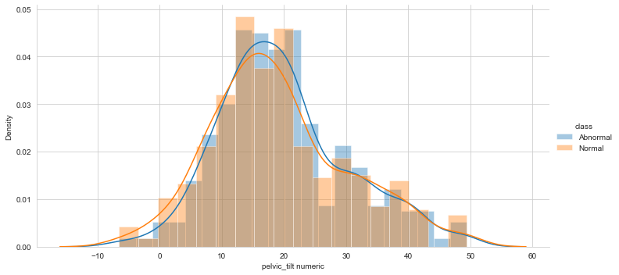
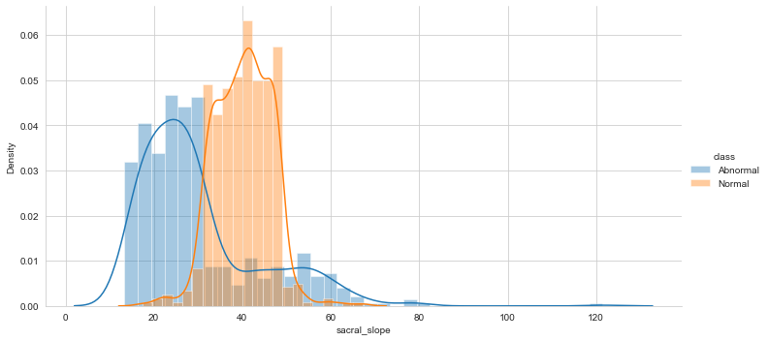
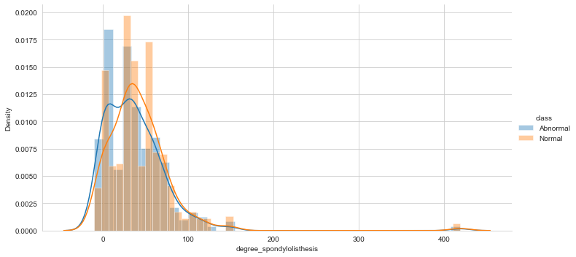

Slide 17
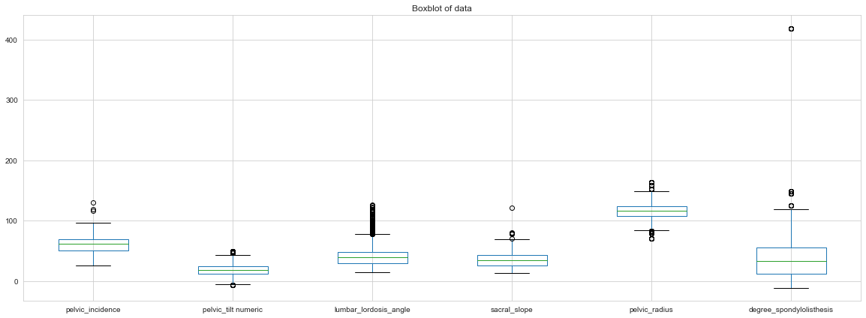
Dataset.
Conn.
Box plots are used to show distributions of numeric data values.
17

Slide 18
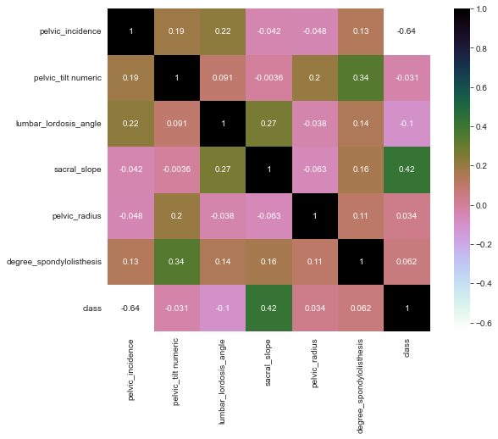
Dataset.
Conn.
Representing the correlation between features and some of them using heatmap function
18

Slide 19
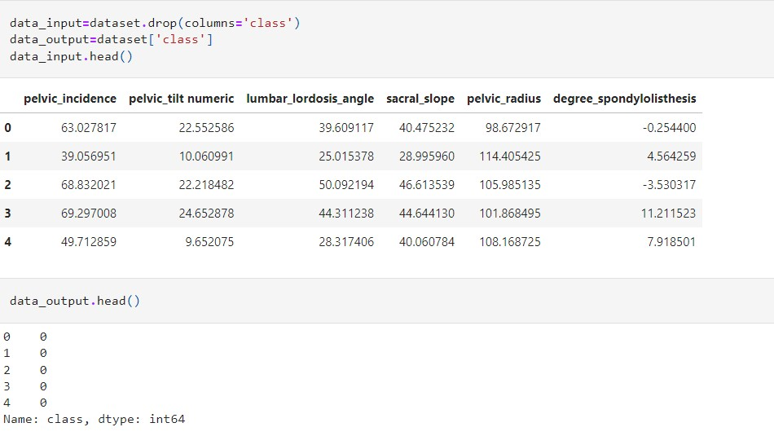

Data preprocessing for machine learning
Splitting dataset
Input data.
Output data
19

Slide 20
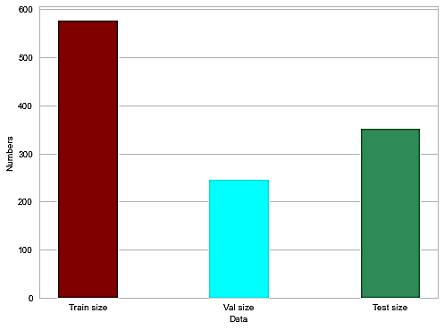
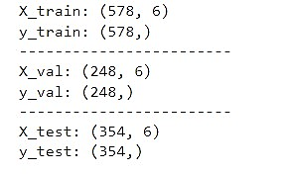
Data preprocessing for machine learning
Splitting Datasets
We need to split our dataset to 3 sets: Training, Validation, and Test data subsets.
20

Slide 21
The Algorithms used to Voting classification
(KNN, Naive Bayes, Decision Tree )

Slide 22
The Algorithms used to classification
Hyper-parameter tuning
When we build a machine learning model ,we have a number of Hyper-parameters that will determine how our model looks like.
Changing the values of these variables will affect the accuracy of our model.
We need to find the best hyper-parameters for our model to achieve the best accuracy.
22

Slide 23
KNN Algorithm.

Slide 24
The Algorithms used to classification
KNN Algorithm.
the number of neighbors
Hyper-parameter in KNN
The weights
24

Slide 25
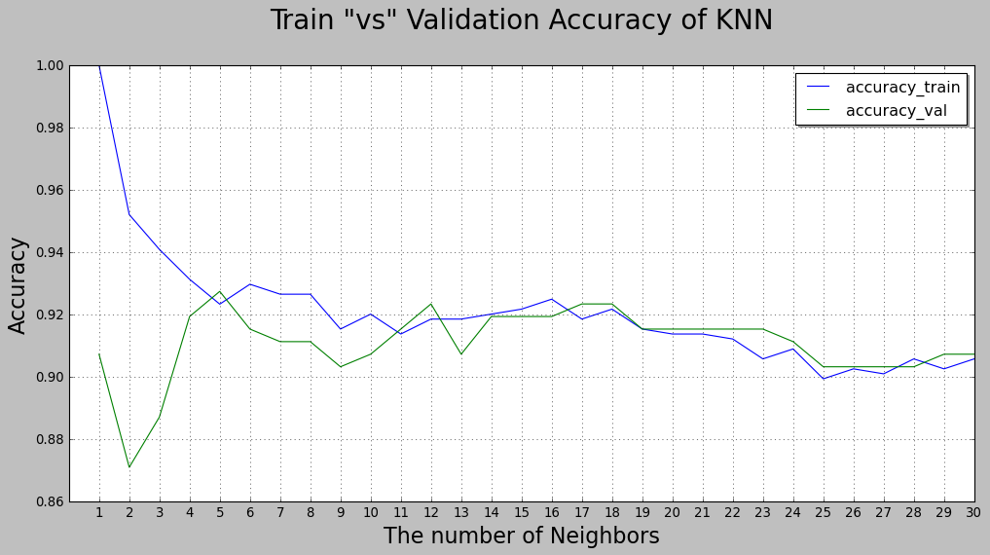
The Algorithms used to classification
KNN Algorithm.
The best neighbors =5
25

Slide 26
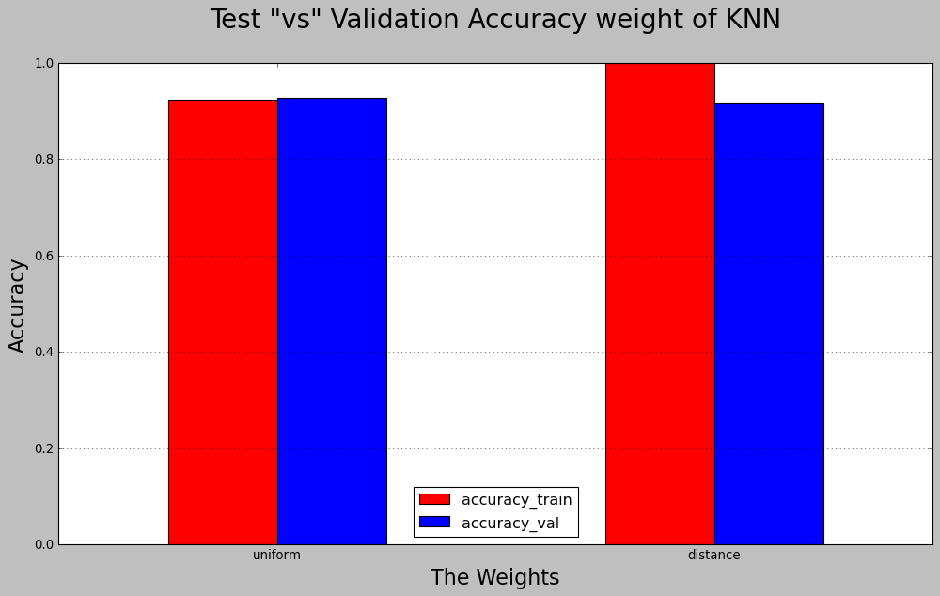

The Algorithms used to classification
KNN Algorithm.
26

Slide 27
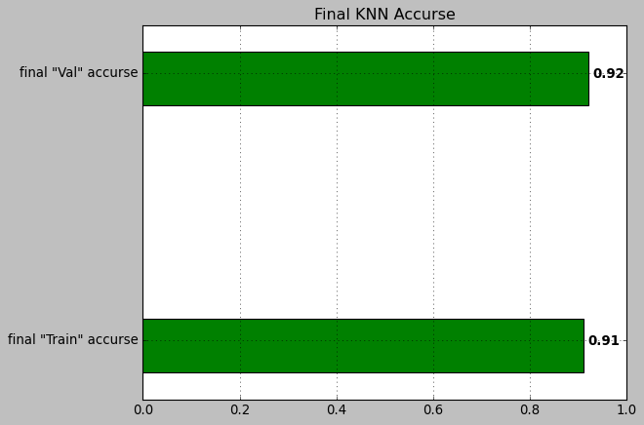
The Algorithms used to classification
KNN Algorithm.
Then we applied the KNeighborsClassifier using
the best K =(11) ,weight=“uniform”
27

Slide 28
Naive Bayes Algorithm.

Slide 29
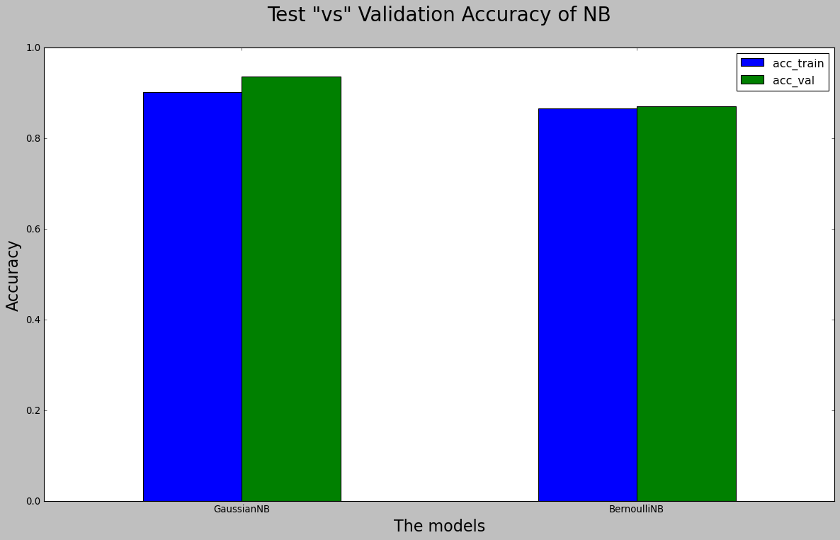
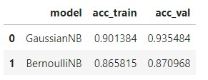
The Algorithms used to classification
Naive Bayes Algorithm.
GaussianNB model win
29

Slide 30
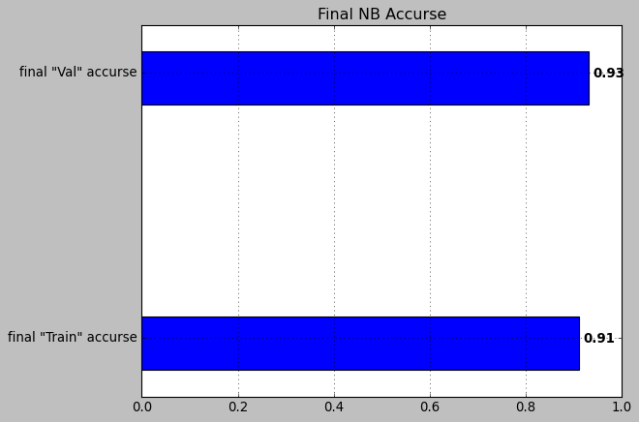
The Algorithms used to classification
Naive Bayes Algorithm.
We applied GaussianNB() in the data
30

Slide 31
Decision Tree Algorithm

Slide 32
The Algorithms used to classification
DT Algorithm.
The max depth of tree
Hyper-parameter in DT
The Criterion
32

Slide 33
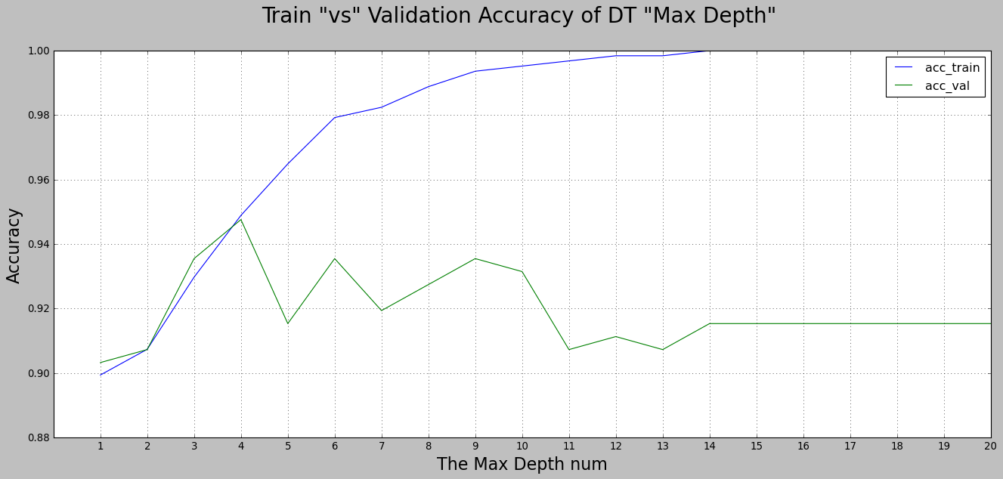
The Algorithms used to classification
Decision Tree Algorithm
The best max depth=4
33

Slide 34
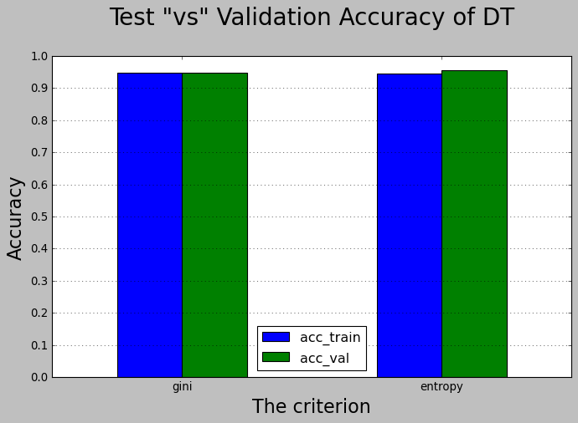
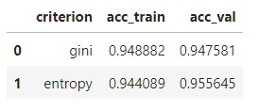
The Algorithms used to classification
Decision Tree Algorithm
34

Slide 35
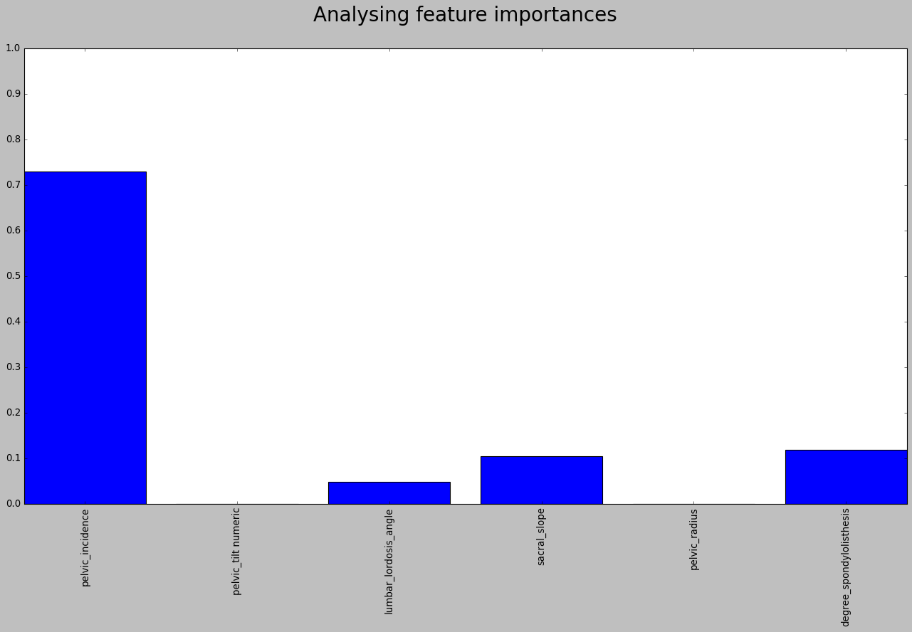
The Algorithms used to classification
Decision Tree Algorithm
35

Slide 36
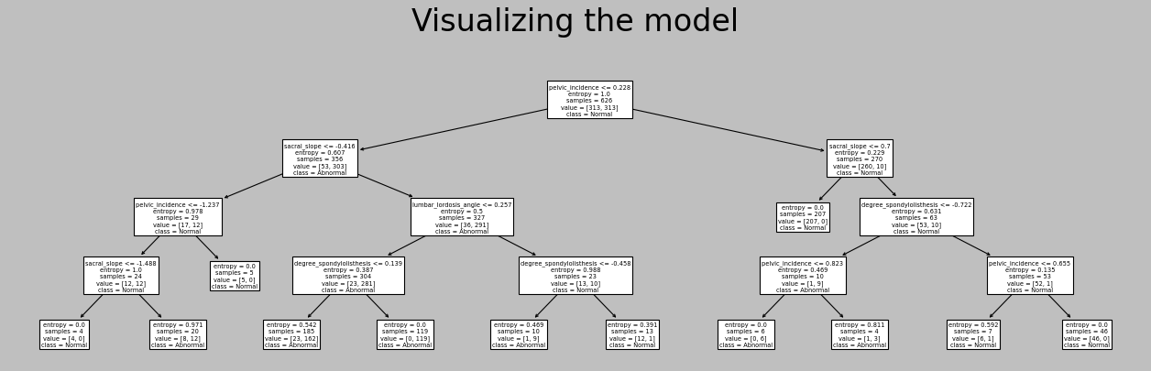
The Algorithms used to classification
Decision Tree Algorithm
36

Slide 37
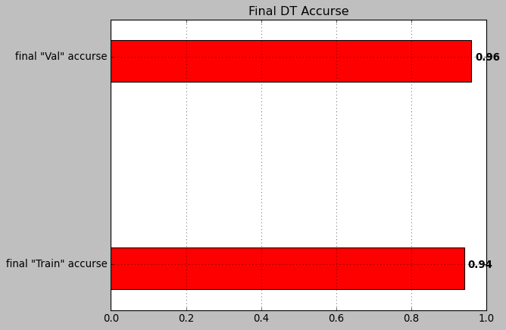
The Algorithms used to classification
Decision Tree Algorithm
We applied the DecisionTreeClassifier
with max depth=4, criterion=“entropy”
37

Slide 38
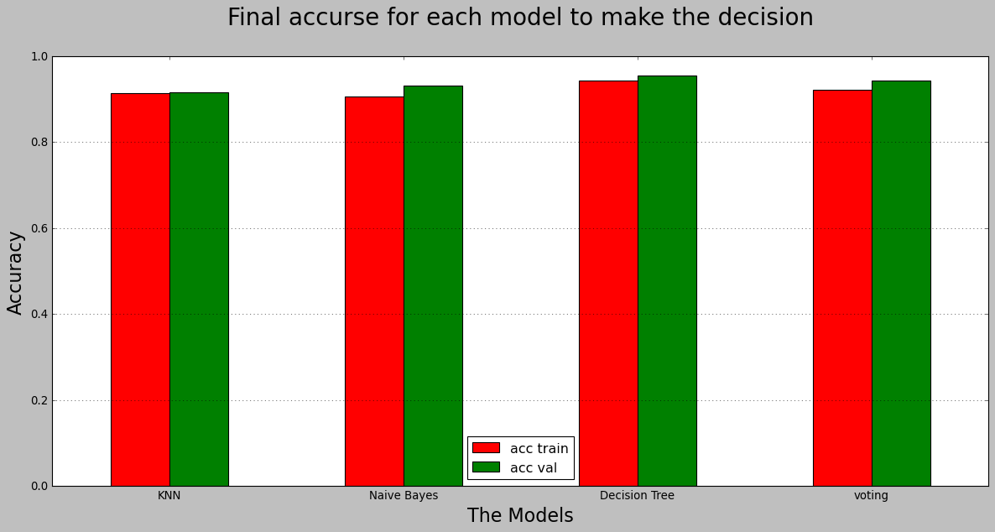
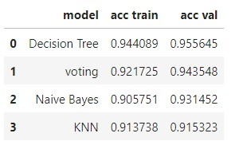
The Algorithms used to classification
Decision Tree Algorithm
Voting to make decision
38

Slide 39
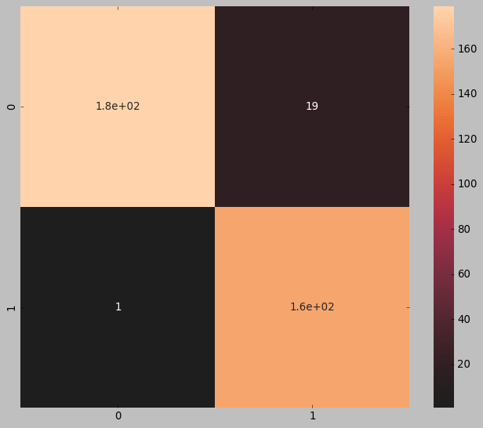
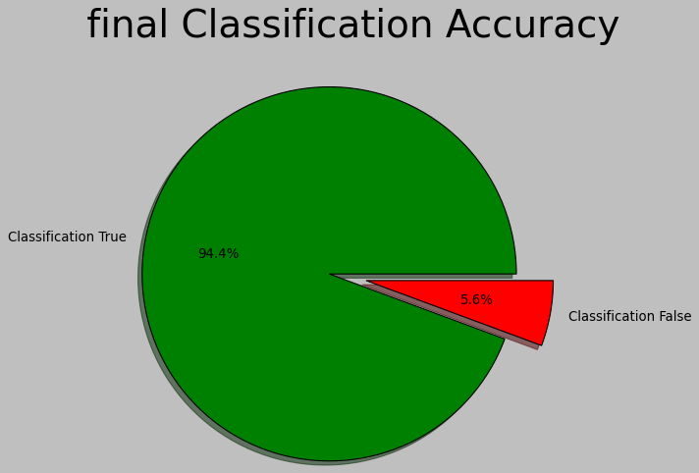
Final model test with test values.
Final confuse matrix and accurse.
Confusion matrix
Final accurse.
39

Slide 40
Conclusion.

Slide 41
Conclusion.
The Decision of solving problem.
When a new orthopedic patient comes to the hospital, we will be able to largely classify if he is normal or abnormal by adding some new biomechanical features to the model.
We can conclude that "Decision Tree Algorithm" works well for data because it has a high accuracy of 95.5%.
41

Slide 42
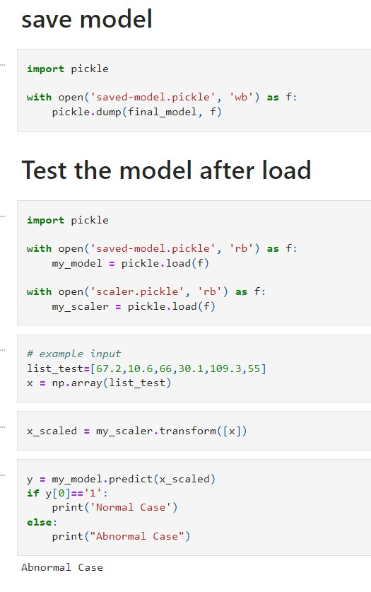
Conclusion.
The Decision of solving problem.
Save model to use it later.
Load model to use.
42

Slide 43
Conclusion.
The Decision of solving problem.
Test example.
Make decision.
43

Slide 44
♥♥ THANK YOU! ♥♥
Any Questions?

